Slide 1
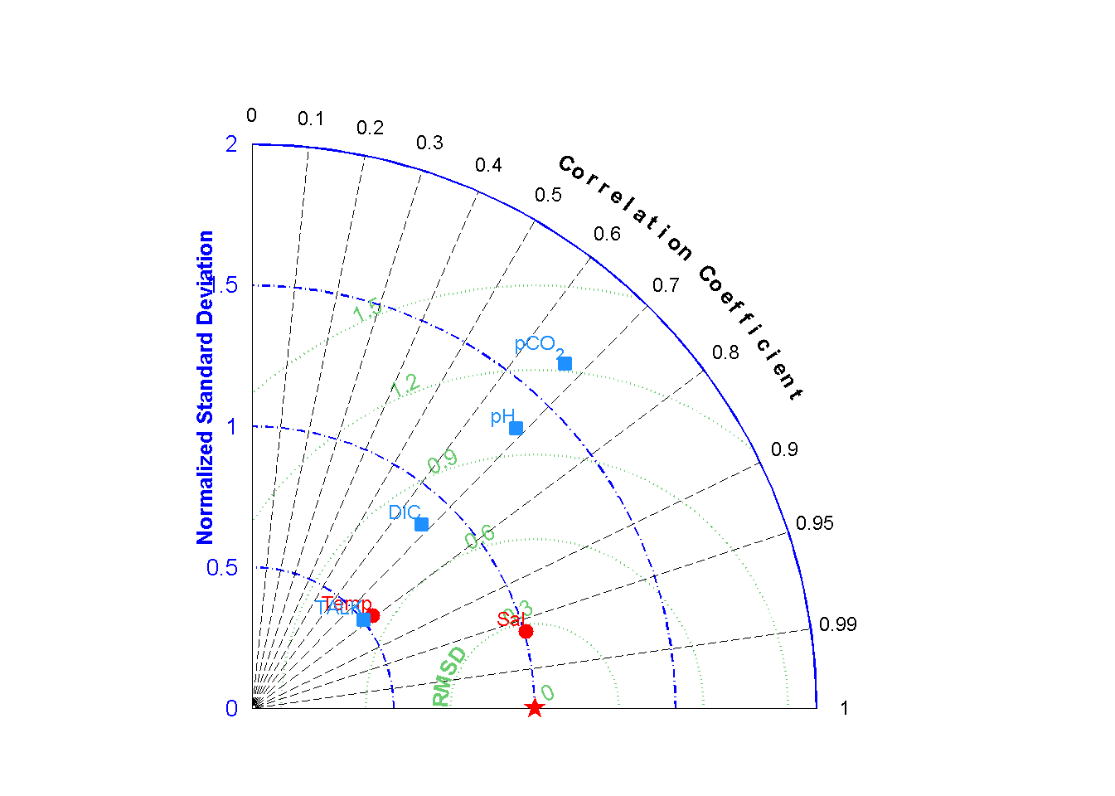
Notes:
Figure 3. Normalized Taylor diagram illustrating the model skills of simulating the salinity, water temperature, TA, pH, DIC and pCO₂. Observing period: 15th July 2006 to 24th August. 2006.

